Slide 1
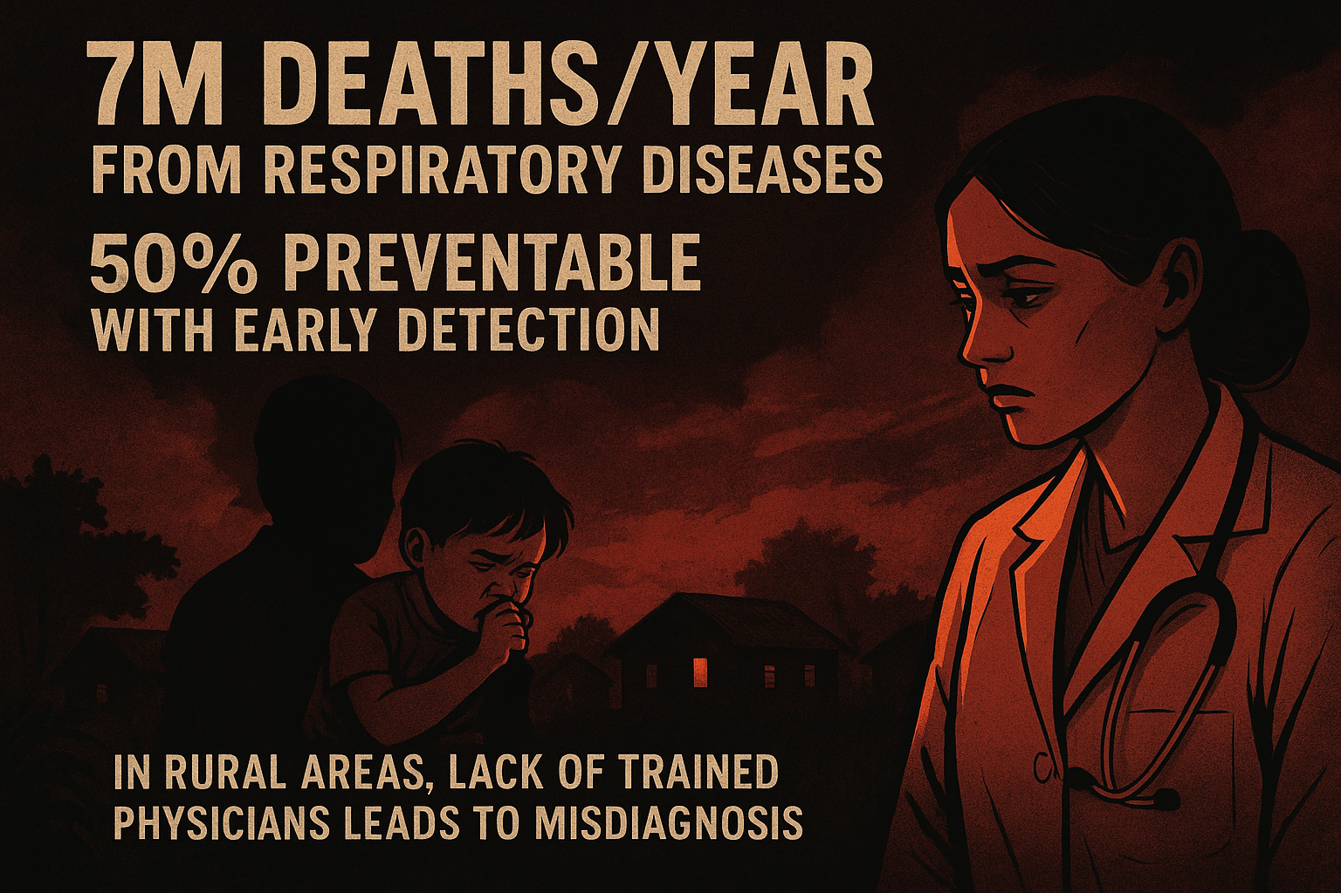

Slide 2
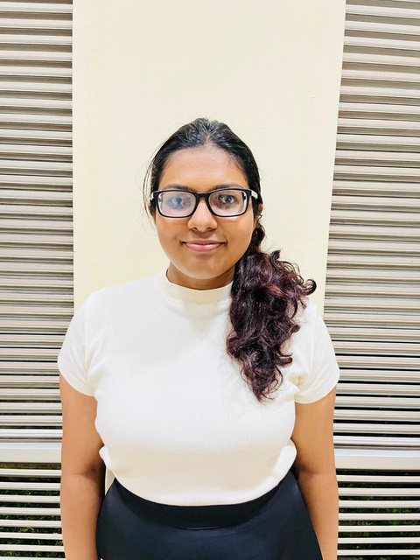
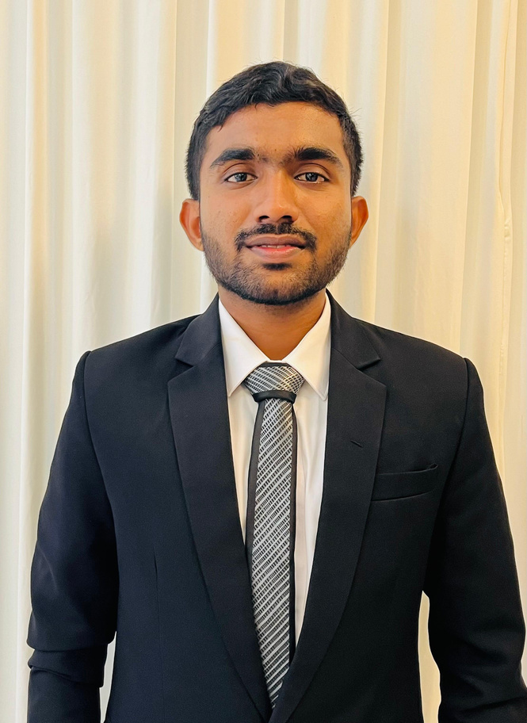

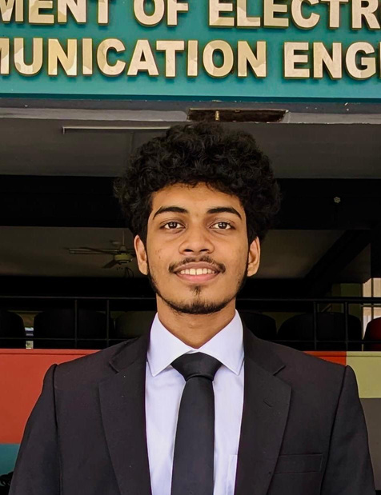

Team Quantumbyte
RANSADI DE ALWIS
DEMITHA MANAWADU
SANUGI WICKRAMASINGHE
SAVINDU WICKRAMASINGHE
ELECTRONIC AND TELECOMMMUNICATION ENGINEERING UNDERGRADUATE
UNIVERSITY OF MORATUWA
ELECTRONIC AND TELECOMMMUNICATION ENGINEERING UNDERGRADUATE
UNIVERSITY OF MORATUWA
ELECTRONIC AND TELECOMMMUNICATION ENGINEERING UNDERGRADUATE
UNIVERSITY OF MORATUWA
BIOMEDICAL ENGINEERING UNDERGRADUATE
UNIVERSITY OF MORATUWA
Medical students of
Faculty of Medicine, University of Colombo

Slide 3

Difficulties when analyzing lung sounds for medical students
Lack of Trained Phycisains in rural areas:Leads to missidentifying

Slide 4

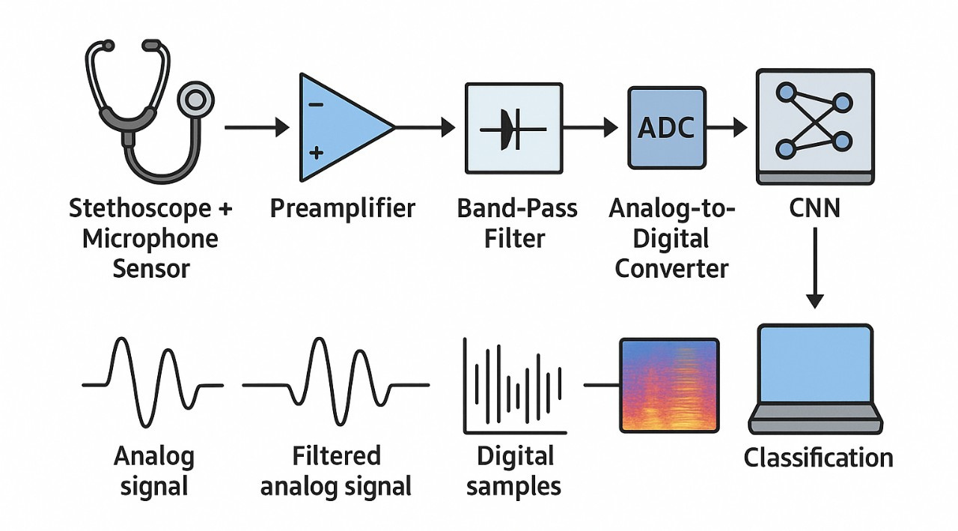
Our Innovation:
AI-Powered Lung Sound Diagnostic System
Transforms a simple stethoscope into an AI-assisted diagnostic tool bridging the diagnostic gap in rural healthcare.

Slide 5

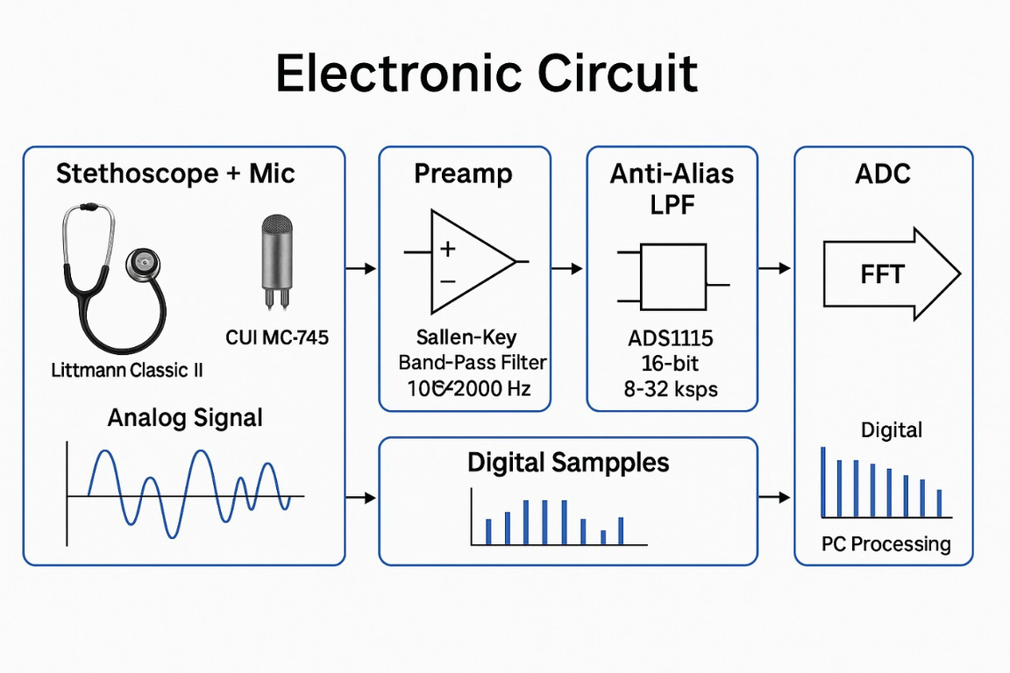
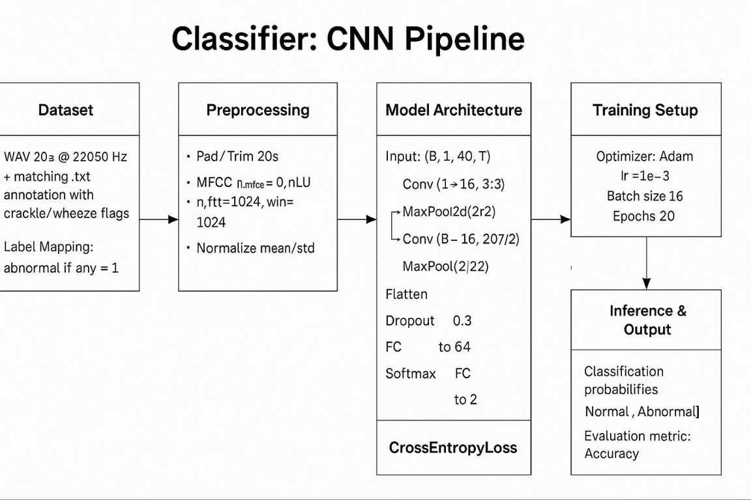

Technical Implementation

Slide 6
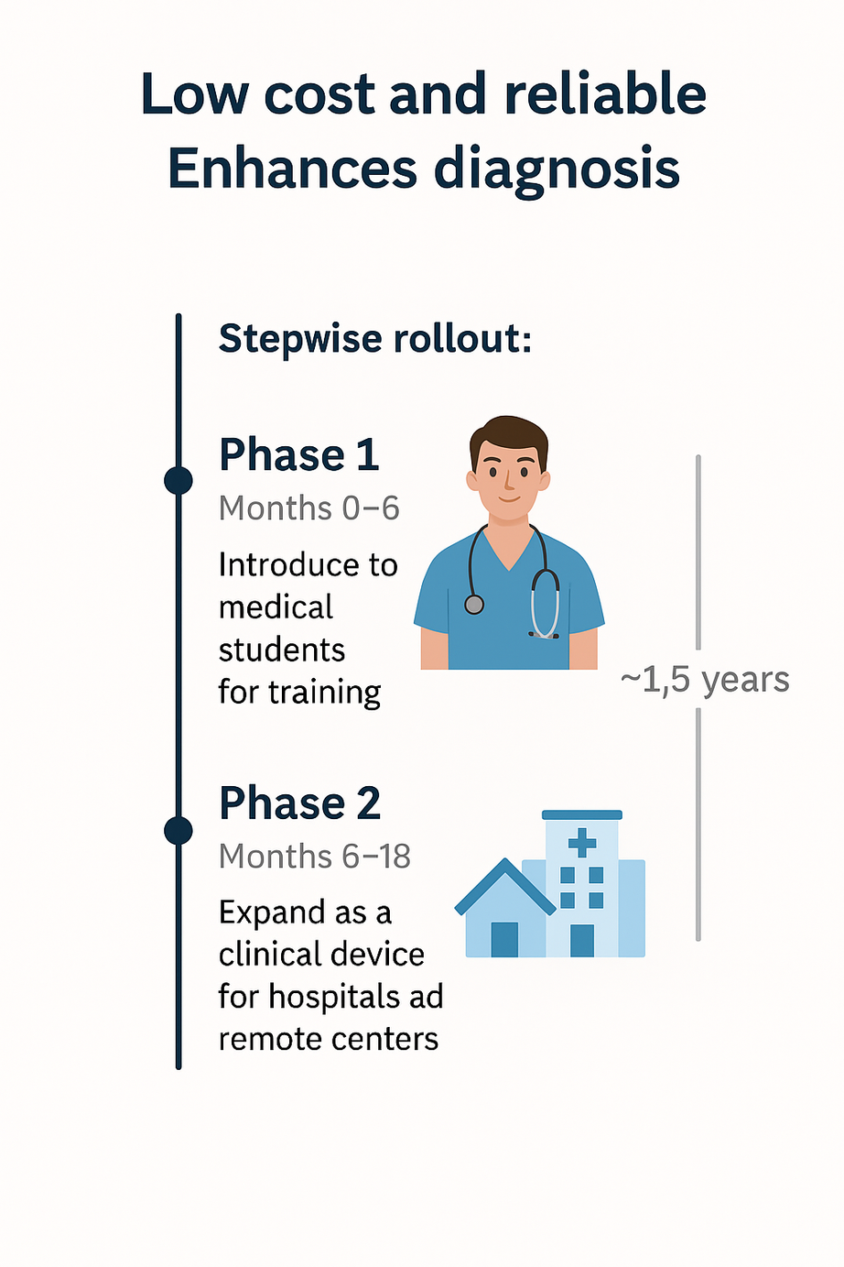

Market Value and Time line
Future Vision

Slide 7
THANK YOU!

